Slide 1
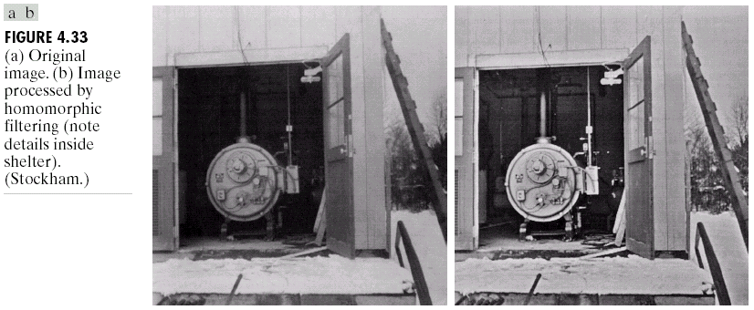
Homomorphic filtering
Many times, we want to remove shading effects from an image (i.e., due to uneven illumination)
  Enhance high frequencies
  Attenuate low frequencies but preserve fine detail.

Slide 2
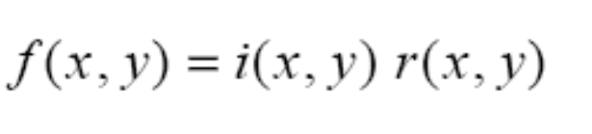
Homomorphic Filtering (cont’d)
Consider the following model of image formation:
In general, the illumination component i(x,y) varies slowly and affects low frequencies mostly.
In general, the reflection component r(x,y) varies faster and affects high frequencies mostly.
i(x,y): illumination
r(x,y): reflection
IDEA: separate low frequencies due to i(x,y)
from high frequencies due to r(x,y)

Slide 3
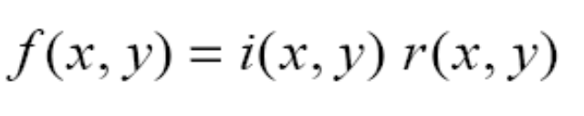

How are frequencies mixed together?
Low and high frequencies from i(x,y) and r(x,y)
are mixed together.
When applying filtering, it is difficult to handle
low/high frequencies separately.

Slide 4
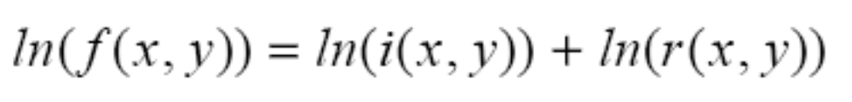
Can we separate them?
Idea:
Take the ln( ) of

Slide 5
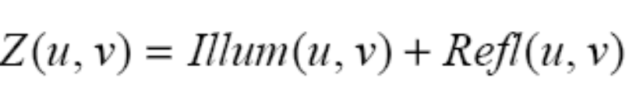
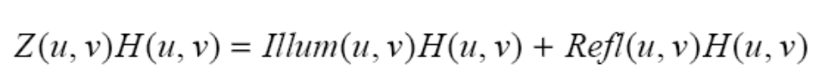
Steps of Homomorphic Filtering
(1) Take
(2) Apply FT:
or
(3) Apply H(u,v)

Slide 6
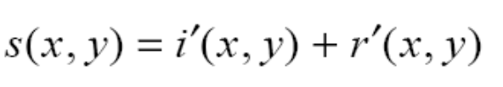


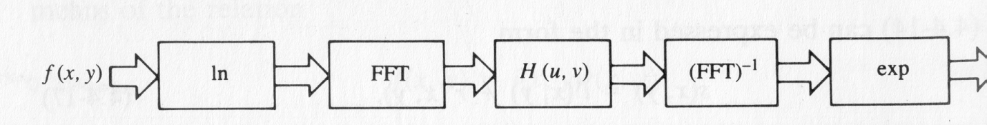
Steps of Homomorphic Filtering (cont’d)
(4) Take Inverse FT:
or
(5) Take exp( ) or

Slide 7
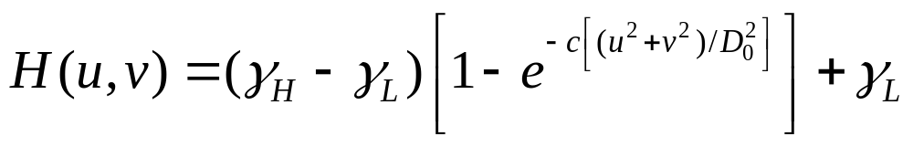
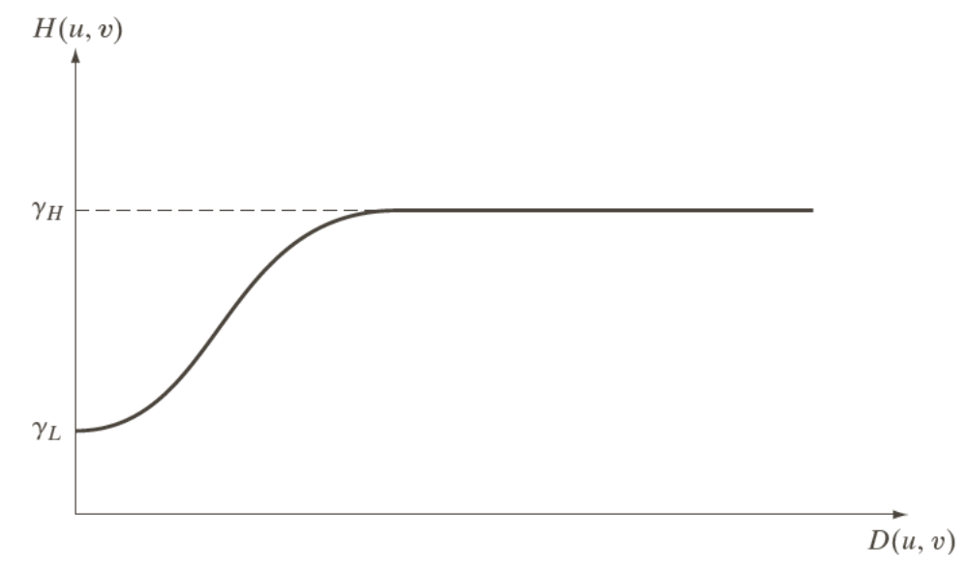
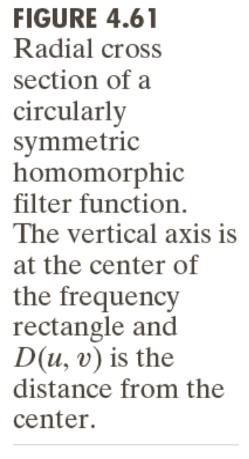
Example using high-frequency emphasis
Attenuate the contribution made by illumination and amplify the contribution made by reflectance
Attenuate the contribution made by illumination and amplify the contribution made by reflectance

Slide 8
Homomorphic Filtering: Example

Slide 9
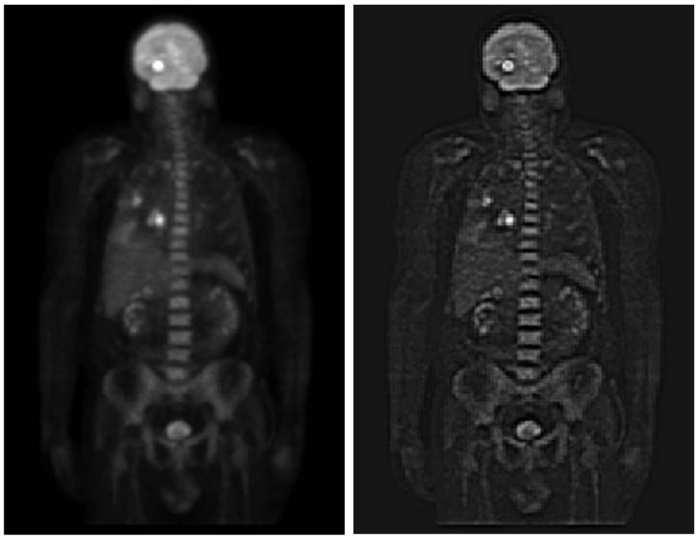
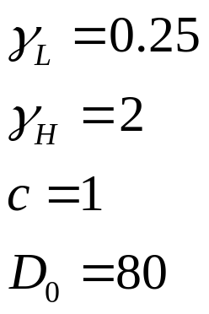
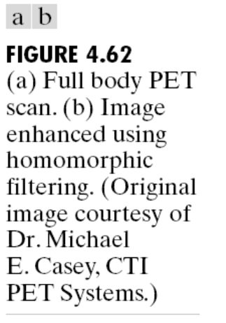
Homomorphic Filtering: Example

